Slide 1
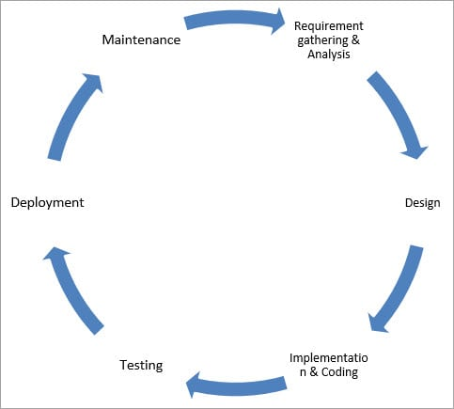
SYSTEM Development Life Cycle
The system development life cycle is a project management model that defines the stages involved in bringing a project from inception to completion. Software development teams, for example, deploy a variety of systems development life cycle models that include waterfall, spiral and agile processes
Stages of the System Development Life Cycle
Requirement gathering and analysis
Design
Implementation or coding
Testing
Deployment
Maintenance

Slide 2
Requirement Gathering and Analysis
During this phase, all the relevant information is collected from the customer to develop a product as per their expectation. Any ambiguities must be resolved in this phase only.
Business analyst and Project Manager set up a meeting with the customer to gather all the information like what the customer wants to build, who will be the end-user, what is the purpose of the product. Before building a product a core understanding or knowledge of the product is very important.
Design
In this phase, the requirement gathered in the SRS document is used as an input and software architecture that is used for implementing system development is derived.
Implementation or Coding
Implementation/Coding starts once the developer gets the Design document. The Software design is translated into source code. All the components of the software are implemented in this phase.

Slide 3
Testing
Testing starts once the coding is complete and the modules are released for testing. In this phase, the developed software is tested thoroughly and any defects found are assigned to developers to get them fixed.
Retesting, regression testing is done until the point at which the software is as per the customer’s expectation. Testers refer SRS document to make sure that the software is as per the customer’s standard.
Deployment
Once the product is tested, it is deployed in the production environment or first UAT (User Acceptance testing) is done depending on the customer expectation.
In the case of UAT, a replica of the production environment is created and the customer along with the developers does the testing. If the customer finds the application as expected, then sign off is provided by the customer to go live.
Maintenance
After the deployment of a product on the production environment, maintenance of the product i.e. if any issue comes up and needs to be fixed or any enhancement is to be done is taken care by the developers.

